Slide 1
Fuzziness based semi-supervised multimodal learning for patient’s activity recognition using RGBDT videos.
Group Members:
Muhammad Shehzad Ali Khan
Muhammad Zohaib Aslam Khan
Saifullah Khan
Notes:
ID=d924773e-9a16-4d6d-9803-8cb819e99682 Recipe=text_billboard Type=TextOnly Variant=0 FamilyID=AccentBoxWalbaum_Zero

Slide 2
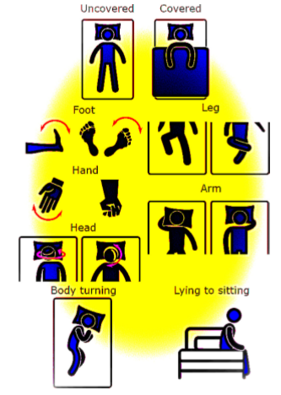
Introduction
Why FSSL ?
3 major contributions of article
FSSL strategy for PAR
Instead of unimodal, use multimodal data
Correlation between labeled input and efficiency of strategy
Database
Synapsis of SSL

Slide 3
Fuzziness semi supervised learning
SSL is twofold technique; first small amount of labeled data is used to train initial classifier. In second step initial classifier is used to annotate unlabeled data. Then this new labeled data is used in initial classifier until attain best scores or some threshold.
In 2015 Wang at el. Purpose the relationship between Fuzziness and misclassification of a classifier. A classifier with low fuzziness in its output vector have low probability of misclassification.
""If initial classifier efficiency lies within 70% to 80%, high performance of SSL can be achieved.""

Slide 4
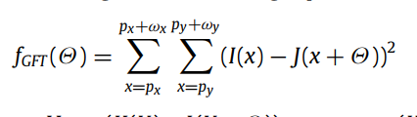
Body Motion Tracking:
GFT :
It is pixel tracking technique.
LKT:
And it is used to track those points.
20 x 20 Grid of ROI To make Good use of GFT and LKT
Motion map of high intensity of ROI is produced which poses 3 poles of features:
Represent Video frame
Represent Traced feature points
Represent Motion intensity of second feature over First feature

Slide 5
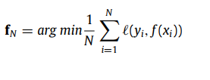
Feature Extraction Techniques:
1. Principal Component Analysis 2.Radon Distance Features
3.First Difference of the Motion Map 2. Primitive Radon Features
Rationality of F-SSL:
To generalization of Model, we must obtain optimal parameters so that empirical error is minimized
According to VC dimension theory:
Numbers of Labeled Examples generalization ability of Model

Slide 6
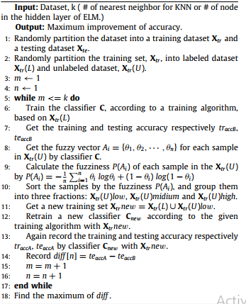
Methodology of FSSL:
Initial Classifier
4 experiments
With Fusion /Without Fusion
Non-iterative neural network with single hidden layer(ELM)
FKNN With Fusion /Without Fusion

Slide 7
